Slide 1
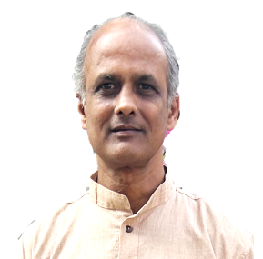

AI/ML Basic Training
Dr. Ganesh Changavar
Indhra Kiranu, N A
Fleet Monitoring & System Analysis
TT/S43, May 2024

Slide 2

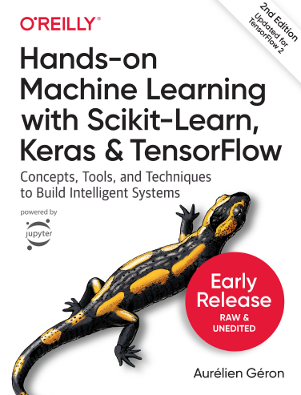
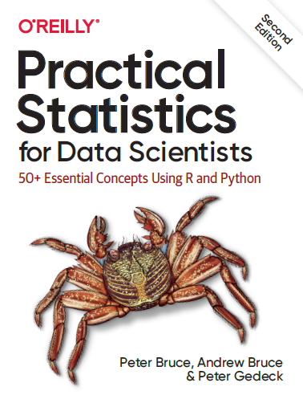
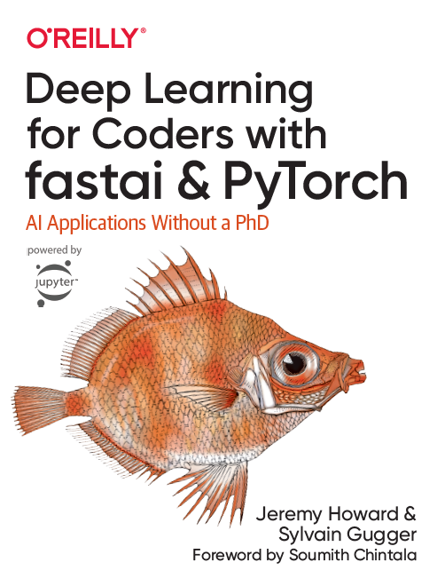
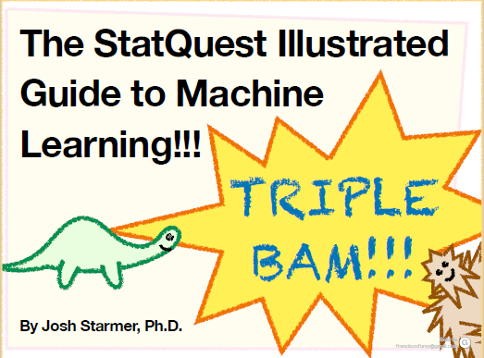
Agenda
Internal
References →
Clustering
Trees
Ensemble Methods
Resources: AI_ML_Trainings
.. Scikit-learn,
Fast.AI,
Kaggle….

Slide 3
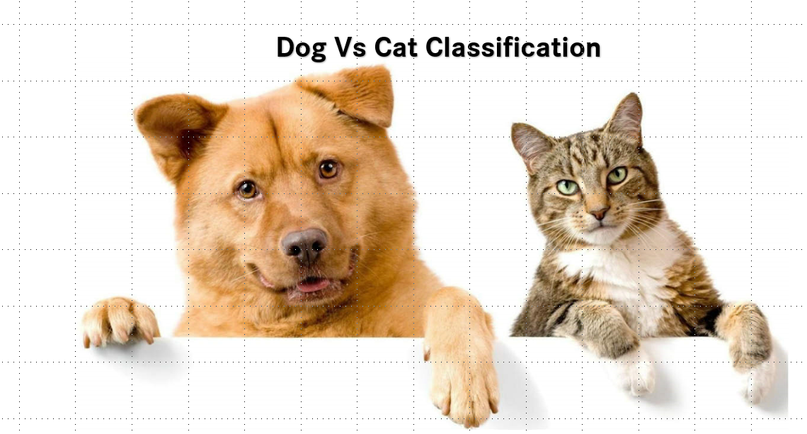
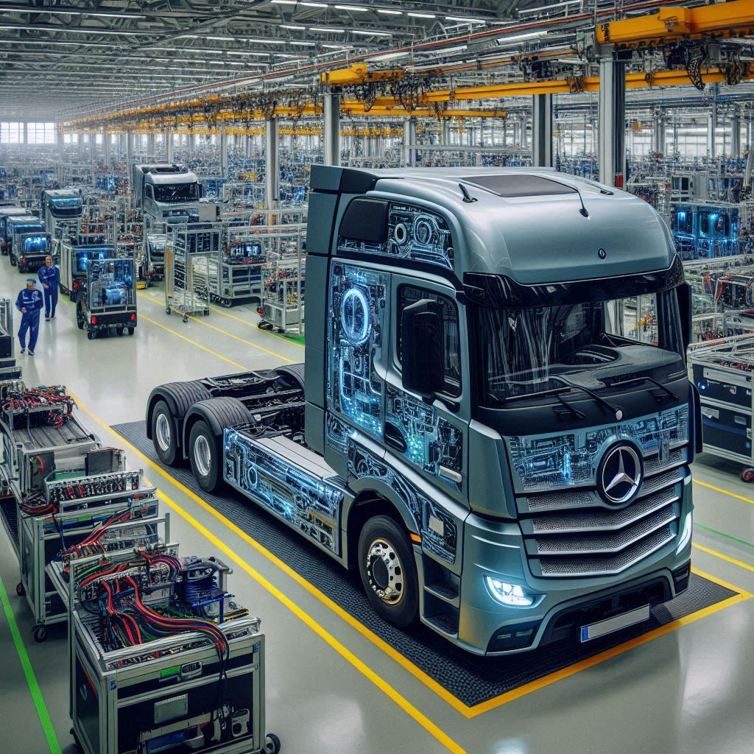
Unsupervised Learning(1)
Theory
Pre-Context !!
ML_Learnings/k-means-dbscan-clustering-theory-housing-price.ipynb at main · indhra/ML_Learnings (github.com)
Deals with problems in which data doesn’t have labels.
We only have inputs X but no outputs Y for the same.
In Supervised Learning:
We have inputs as pictures and outputs as Dogs or Cats that are already tagged to each image.
In Unsupervised Learning :
Building a system that will take pictures on a manufacturing production line and detect which items are defective or normal. In the beginning this requires long human hours to sit down and manually label the pictures. Instead of this wouldn’t it be great if the algorithm could just exploit the unlabeled data without needing humans to label every picture ?

Slide 4
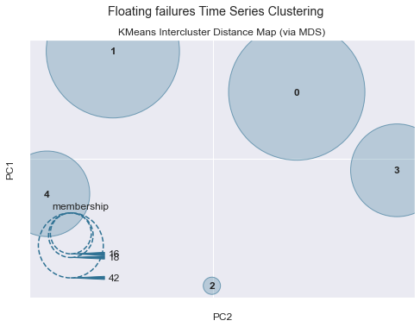
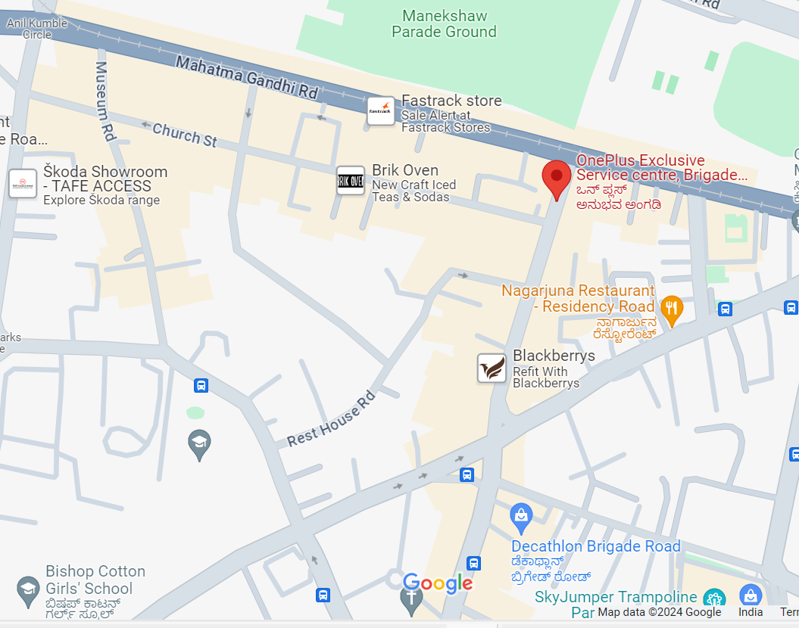
Unsupervised Learning(2)
Theory
Few of Unsupervised Learning tasks and algorithms:
Clustering : The goal is to group similar instances together into clusters - Automated Multi-variate Time series Issue Analysis
Anomaly Detection : Is to learn what ‘normal’ data looks like and use this to detect abnormal instances: eAxle failure
Density estimation : To estimate the probability density function of a random process that created the dataset : DBSCAN – Google maps rush in a region
Dimensionality reduction : In modern ML problems, there are thousands a features available and PCA like model creates a newer feature based on many features available.
Unsupervised Learning Vs Reinforcement Learning♬ :
RL method does trail and error approach, e.g. A robot must travel point A to point B, it can take any path given no restrictions.
A Supervised Learning problem can be converted as Unsupervised learning problem, but not the other way around.
Notes:
DBSCAN – DENSITY BASED SPATIAL CLUSTERING OF APPLICATIONS is also a non-parametric models

Slide 5

Clustering
Theory
Machine learning
Regression
Classification
Clustering
Just like in classification, each instance gets assigned to a group.
Methods:
Distance Based methods: K-Means
Hierarchical Methods
Density Methods
The performance of each algorithm depends on the unknown properties of the probability distribution function that the data was drawn from
There is no universal definition of what a cluster is: it really depends on the context, and different algorithms will capture different kinds of clusters.

Slide 6
K-Means Clustering
Theory
It’s a non-parametric model, i.e. there is no set of fixed parameters that are used to train the model
Here in this case, the no. of clusters – ‘K’ in K-Means
You must find the no. of clusters –K that the algorithm can use to create groups
The value of K is a hyperparameter that must be tuned by the data scientist, there are some techniques available for selecting K but none of them proven optimal.
Most of those techniques require the expert to make an ‘educated guess’ by looking at some metrics like Silhouette score
It uses squared Euclidean distance as a measure
It’s a General-purpose model for an even cluster size
This can be scaled to very large samples and medium no. of clusters
Notes:
Linear regression is a parametric model since the no.of parameters in the model is fixed in the beginning lets two inputs and one output, then y = m1x1 + m2x2 + c, thus total 3 parameters that is fixed

Slide 7
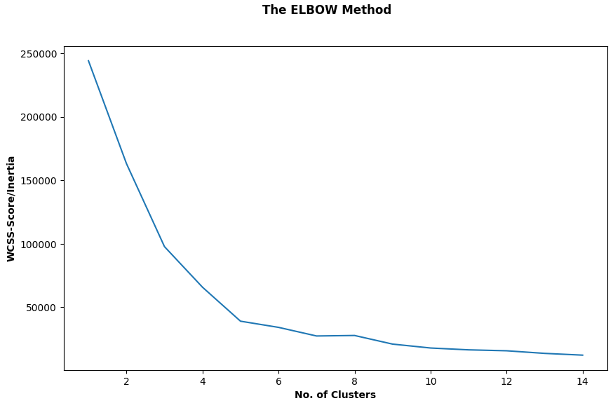
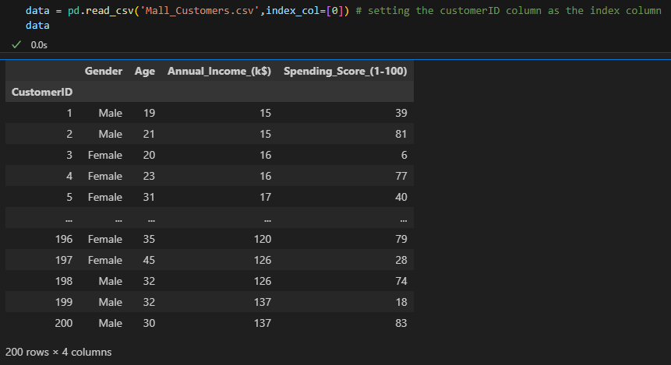
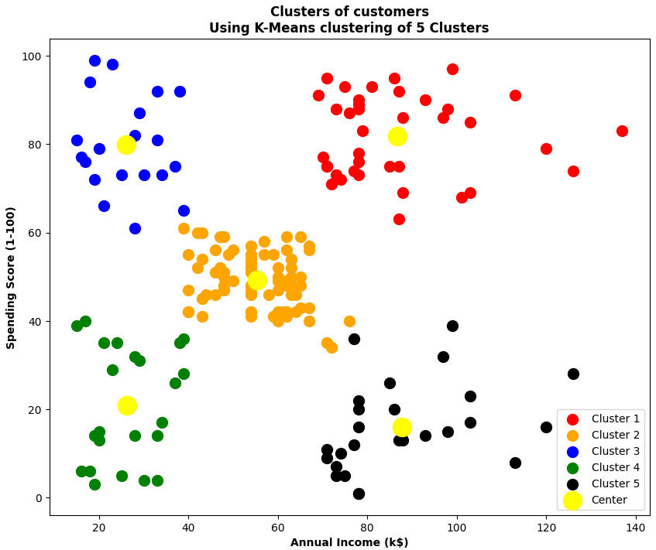
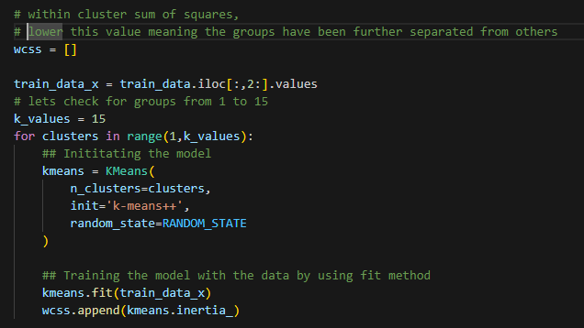
Clustering
Coding
Q: Based on many customer’s purchase history check for viable, window shopper, rare purchaser, etc., resulting in clustering of customers in different groups.
Notes:
ML_Trainings/Clustering/clustering_basics_shopping_customers_segmentation.ipynb at main · indhra/ML_Trainings (github.com)

Slide 8
Clustering
Math’s
First you choose K – the no. of clusters, then randomly get K centroids either from the input data or initialize the centroids in each range of values.
Compute the distance from each sample X to each centroid c using some metric – Euclidean distance.
Assign the closest centroid to each sample X
Calculate the average distance within a cluster based on all the samples in it.
Replace the above average as the new centroid for that cluster, if the previous centroid is different.
Repeat the step 2, 3 and 4, and check for the update in the new centroid based on the hyperparameter

Slide 9
Trees
Theory
Txt

Slide 10


Slide 11
Topics
Trees
Game Time
Stumps
Decision Trees Classifier & Regression
Parameters
Hyper-parameters
Regularization
Impurity Measure
CART
Ensemble
Voting
Stacking
Bagging
Random Forests
Boosting
Adaboost
Gradient boost

Slide 12
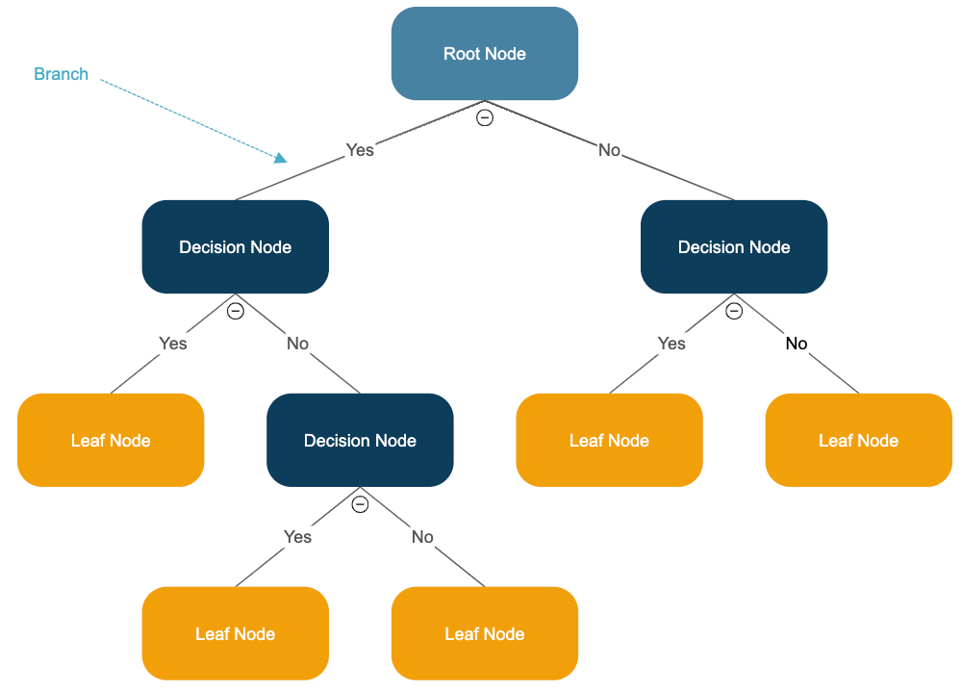
Tree
A decision tree uses a tree looking structure to represent several possible decision paths and an outcome for each path.
Game Time
Notes:
Trees is that they require very little data preparation, they don’t require feature scaling o r centering at all unlike NN or K-means

Slide 13

Tree
If you have ever played the game Twenty Questions, then you are familiar with decision trees.
For example:
• “I am thinking of an animal.”
• “Does it have more than five legs?”
• “No.”
• “Is it delicious?”
• “No.”
• “Does it appear on the back of the Australian five-cent coin?”
• “Yes.”
• “Is it an echidna?”
• “Yes, it is!”
This corresponds to the path:
“Not more than 5 legs” → “Not delicious” → “On the 5-cent coin” → “Echidna!”
In an idiosyncratic (and not very comprehensive) “guess the animal” decision tree
Game

Slide 14
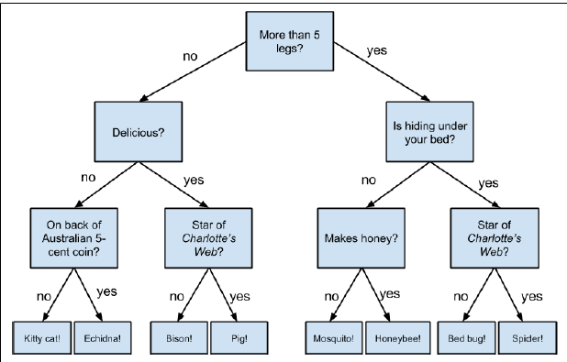
Trees
A ‘ guess the animal’ decision tree
Game to Trees
Notes:
A ‘ guess the animal’ decision tree
DT is easy to understand,
When they reach a prediction they are completely transparent , unlike other models.
Finding an optimal decision tree is a complex problem & hard to train.
Over fitting and generalization of DT is a challenge

Slide 15
Trees Terminologies
Root Node
White box models, is easy to interpret and fairly intuitive
Intermediate Node
Leaf
Notes:
A ‘ guess the animal’ decision tree
DT is easy to understand,
When they reach a prediction they are completely transparent , unlike other models.
Finding an optimal decision tree is a complex problem & hard to train.
Over fitting and generalization of DT is a challenge
Based on CART algorithm this produces only binary trees – non leaf nodes always have two children i.e only yes/no answers.
Algos such as ID3 can produce DT with nodes that have more than two children

Slide 16
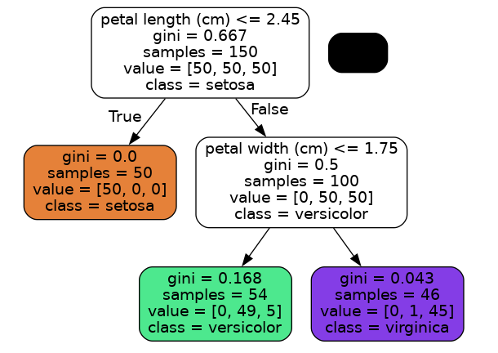
Parameters
Values that are learnt from the data and exclusive to the model.
EX: Y = mX + c
m & c are parameters / values obtained by the model over training on the data
Notes:
Values that are learnt from the data and exclusive to the model.
No external inputs are required for this

Slide 17
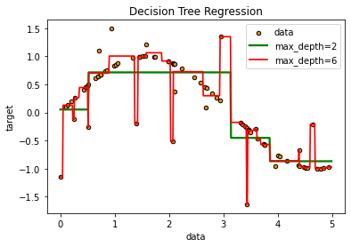
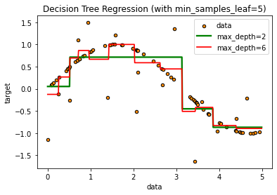
Hyper Parameters
**Parameters that cannot be learnt from the data or external to the model
Regularization
Leads to reduced overfitting,
Better generalization to unseen data,
Less complexity,
Higher modelling time due to vast search
Notes:
At least 6 hyper parameters needs attention with tunning

Slide 18
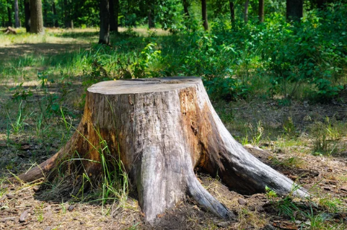
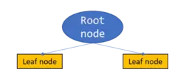
Stumps
Not the Cricket stumps !!
Not the Cricket stumps !!
Stumps are weak Learners .
It has just two leaf nodes.
They are fundamental blocks of models like Adaboost !
Ex: Stump 1
Ex: Stump 2
Gender
Veg
Male
Female
No
Yes

Slide 19
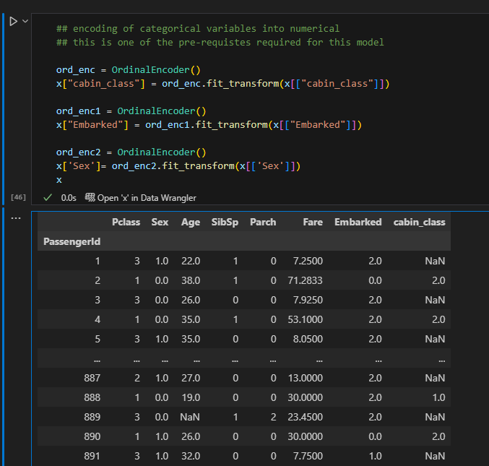
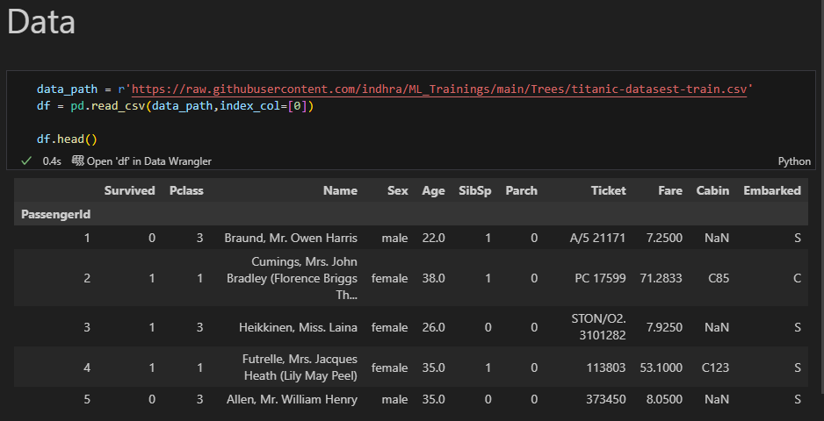
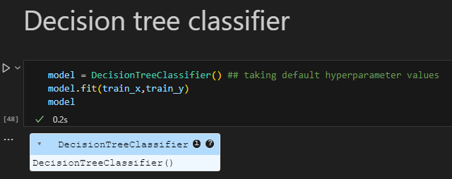
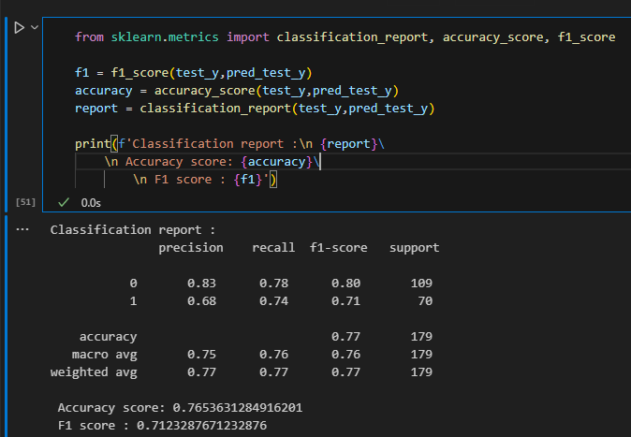
Decision Trees
Coding
Notes:
ML_Trainings/Trees/trees_basics.ipynb at main · indhra/ML_Trainings (github.com)

Slide 20
Trees
Math’s
Value
feature
All you need is splitting the data
What Feature should be considered ?
What value of that feature should be considered ?
Procedure :
Check for all features its impurities
Who will best split the given data
E.g. Gender : Male / Female
Once its done, check for other features available and repeat the above steps

Slide 21
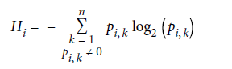
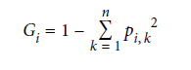
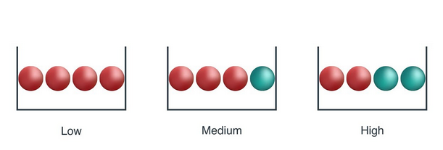
Impurity Measure !!
Math’s
Gini impurity
Entropy
Example
Gini score ranges from 0 to 1, higher score meaning higher impurity
Left bowl has lowest entropy, middle bowl has more entropy and right bowl has highest entropy.
Notes:
A GINI attribute measures its imputity : a node is pure if gini = 0 i.e all training instances it applies to belong the the same class, the lower the better i.e 0
The truth is, most of the time it does not
make a big difference: they lead to similar trees. Gini impurity is slightly faster to
compute, so it is a good default. However, when they differ, Gini impurity tends to
isolate the most frequent class in its own branch of the tree, while entropy tends to
produce slightly more balanced trees

Slide 22
CART !!
Math’s
CART is an algorithm or procedure that a decision tree uses to decide how/where to split a node into two nodes.
CART is a greedy algorithm , it recursively splits and looks possible solution, it can often produce a reasonably good solution, its not guaranteed to be the optimal solution
This belongs to NP-complete Problem it requires O(exp(m)) time - this is why it leads to further advanced trees topics
Notes:
CART algorithm, which produces only binary
trees: nonleaf nodes always have two children (i.e., questions only
have yes/no answers). However, other algorithms such as ID3 can
produce Decision Tree
A greedy algorithm is an algorithmic strategy that makes the best optimal choice at each small stage with the goal of this eventually leading to a globally optimum solution. This means that the algorithm picks the best solution at the moment without regard for consequences

Slide 23



DT is easy to understand,
When they reach a prediction they are completely transparent , unlike other models.
Over fitting and generalization of DT is a challenge
Finding an optimal decision tree is a complex problem & hard to train.

Slide 24


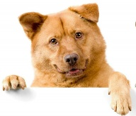
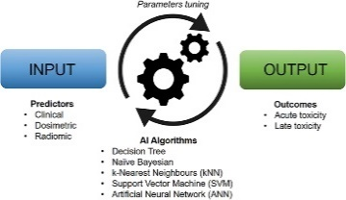
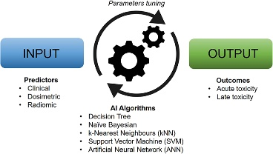
Ensemble - Voting
Eg: Image Classification
Log Reg
SVC
NN
Diverse Predictors
DTrees
dog
Cat
dog
dog
Predictions
Dog !!
Ensemble’s Prediction
(Majority Vote)
Notes:
To most our surprise, this voting Classifier often achieves higher accuracy than the individual classifiers even the best ones.
Even though the classifier is a weak learner , meaning it only performs slightly perform better than random guessing.
This ensemble can still be a strong learner , provided sufficient number of weak learners and they are sufficiently diverse.
This is possible due to Law of large numbers.
If there are 1000 classifiers that are individual correct only 51% of the time , still with ensemble we can hope for 75% accuracy !!, only if the classifiers are perfectly independent

Slide 25
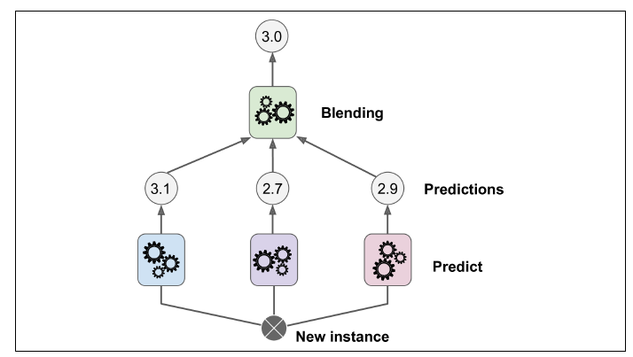
Ensemble - Stacking
Instead of Hard Voting, why don’t we train a model on top of the outputs we obtained
Layer 2
Layer 1
Ex: Aggregating predictions using a blending predictor
Notes:
Each of the bottom three predictors predicts a different value then the final predictor
(called a blender, or a meta learner) takes these predictions as inputs and makes the
final prediction

Slide 26
Trees & Ensemble Part
2
Bagging
Random Forests
Out of Bag Eval
Feature Importance
Boosting
Adaboost
Gradient Boosting

Slide 27
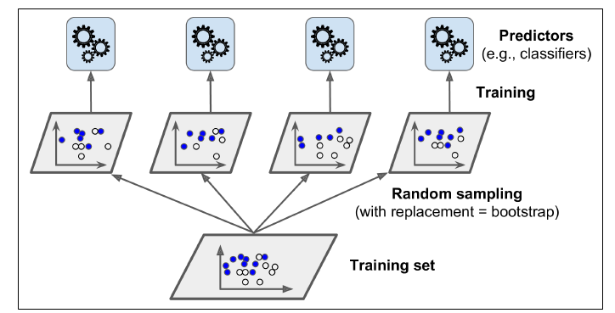
Bagging
One Same algorithm but to train them on different random subsets of the training set.
When sampling is performed with replacement, this method is called Boot strapped aggregation.
Many models will be created independently i.e one model doesn’t have any effect on another model.
Prediction for new instance is obtained by simply aggregating the predictions of all predictors (like Statistical Mode.)
Notes:
Individual predictor has a higher bias than if it were trained on the original training set, but
aggregation reduces both bias and variance.4 Generally, the net result is that the
ensemble has a similar bias but a lower variance than a single predictor trained on the
original training set.

Slide 28
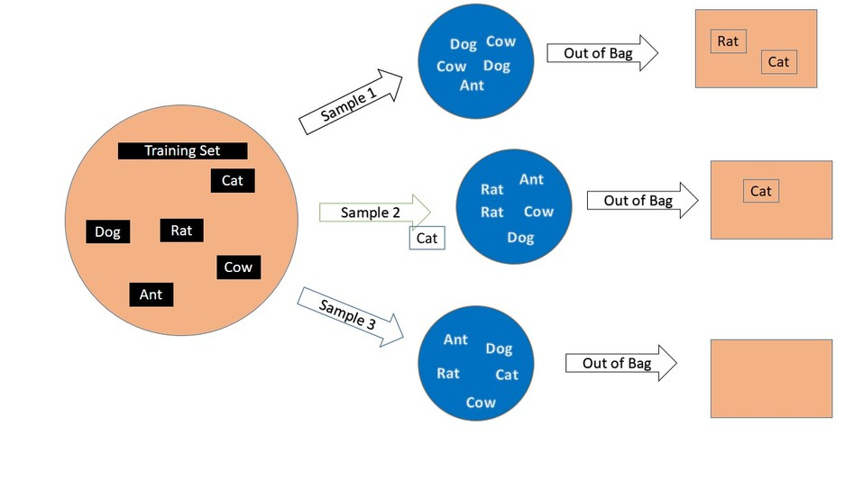
Out-of-Bag Evaluation
Some instances may be sampled several times for any given predictor.
Only 63% of the training instances are sampled on an average of each predictor
Remaining 37% of instances are not sampled – Out of bag (oob) instances
These models does not need additional Cross Validation

Slide 29

Random Forests
RF is an ensemble of Decision Trees
RF looks for best feature while splitting node from random subset of features – this extra randomness is unique to RF

Slide 30
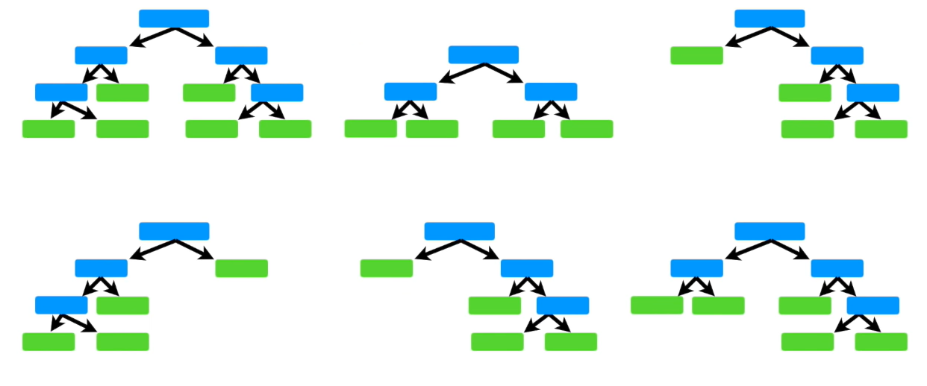
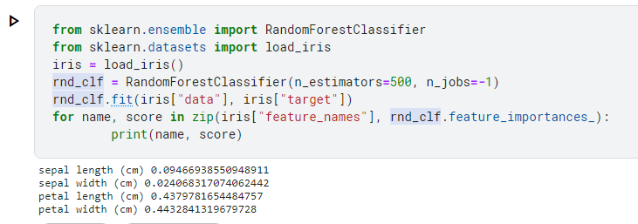
Feature Importance using Random Forests
Best features can be easily extracted from RF
RF measures a feature’s importance by looking at how much the tree nodes that, use that feature reduce impurity on average in that tree
More precisely, it is a weighted average, where each node’s weight is equal to the number of training samples that are associated with it

Slide 31
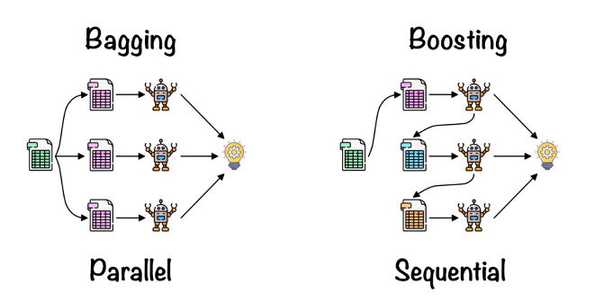
Boosting
Models are created in series.
They are dependent on each other.
i.e. learnings from one model is takeover to next model specially regarding the mistakes that earlier model has done.

Slide 32
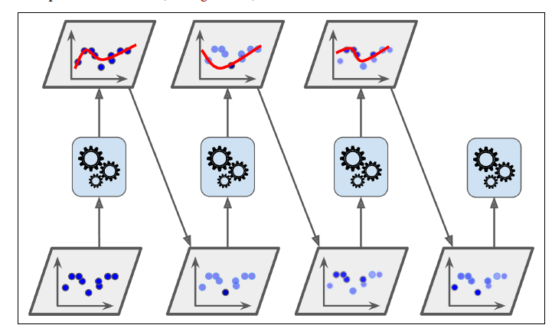
AdaBoost
Models are created in series.
They are dependent on each other.
i.e. learnings from one model is takeover to next model specially regarding the mistakes that earlier model has done.
Predictor 1
Predictor 2
Predictor 3
Predictor 4
AdaBoost sequential training with instance weight updates

Slide 33
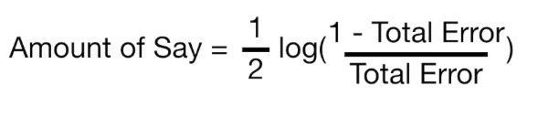
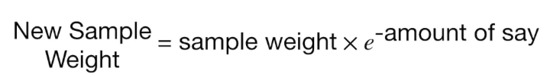
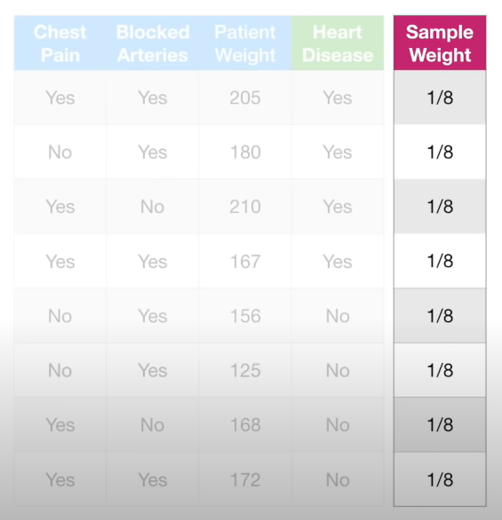
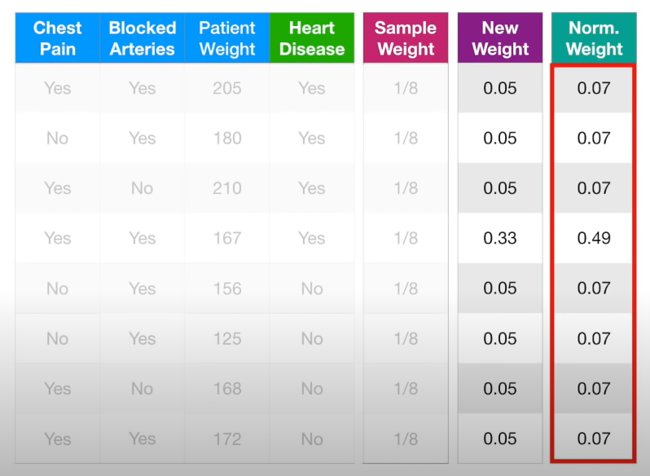
AdaBoost
… Model will emphasize the need for the next stump to correctly classify it by increasing its Sample Weight
Models are created in series.

Slide 34
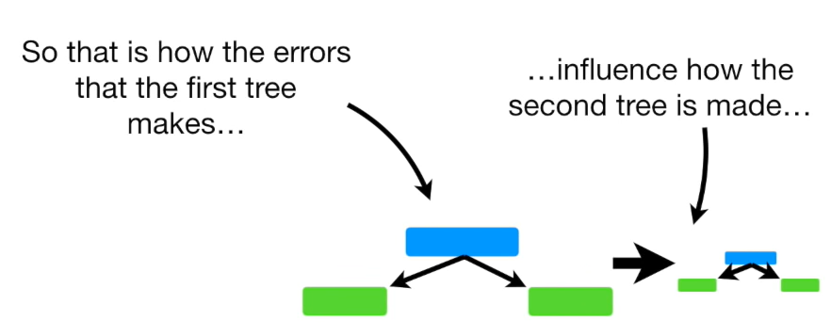
AdaBoost
By Going through sequentially

Slide 35
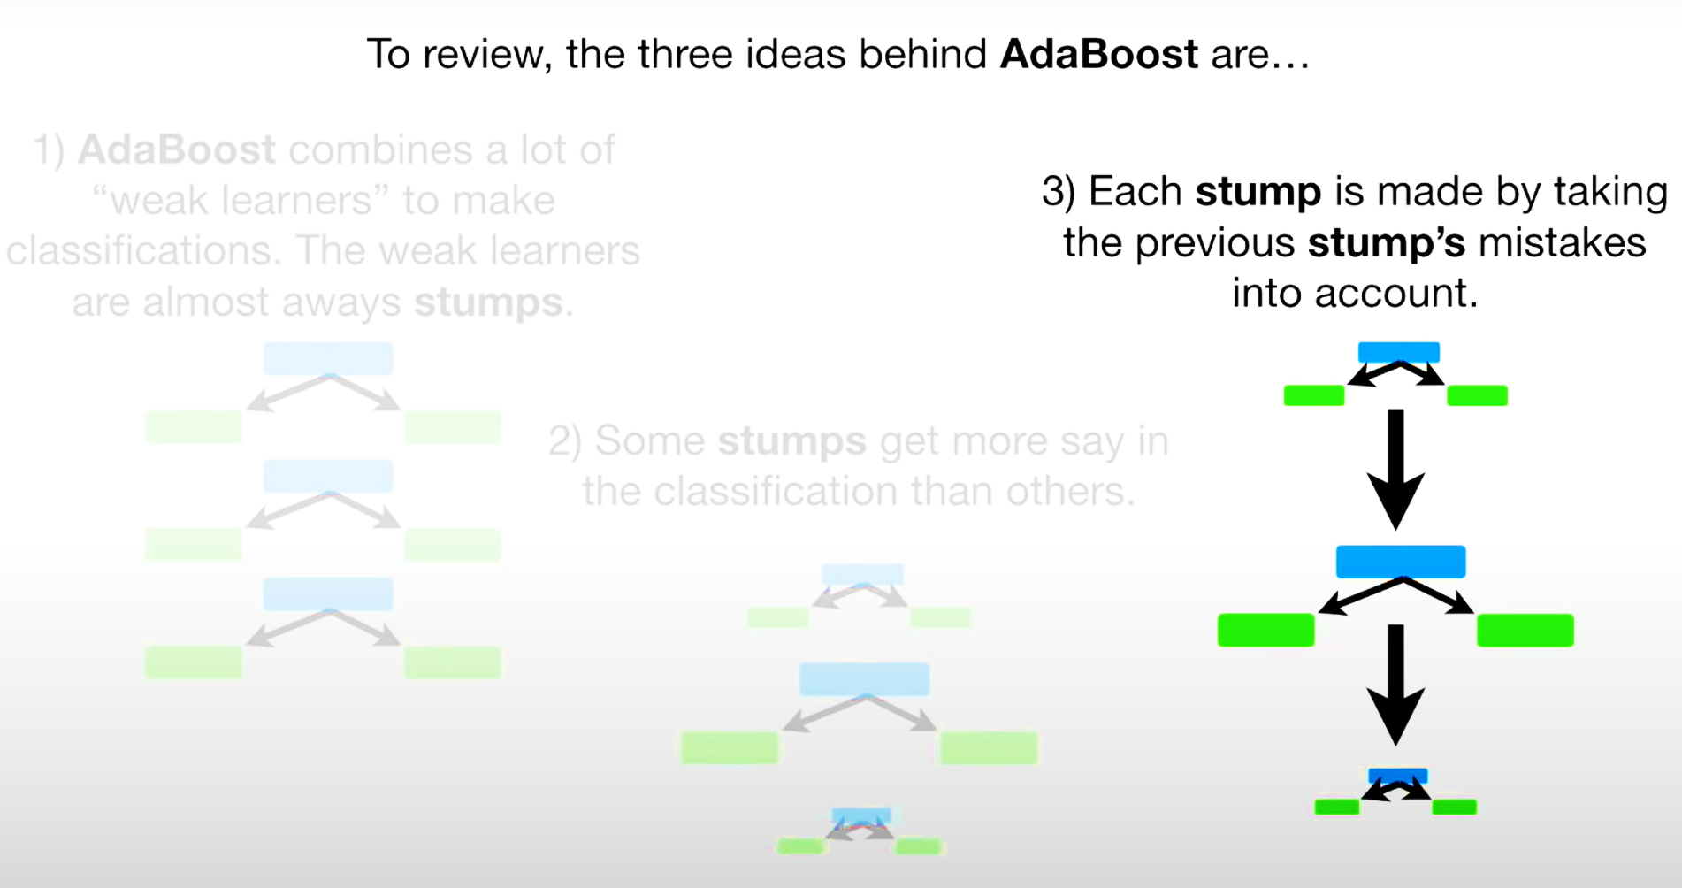
AdaBoost

Slide 36
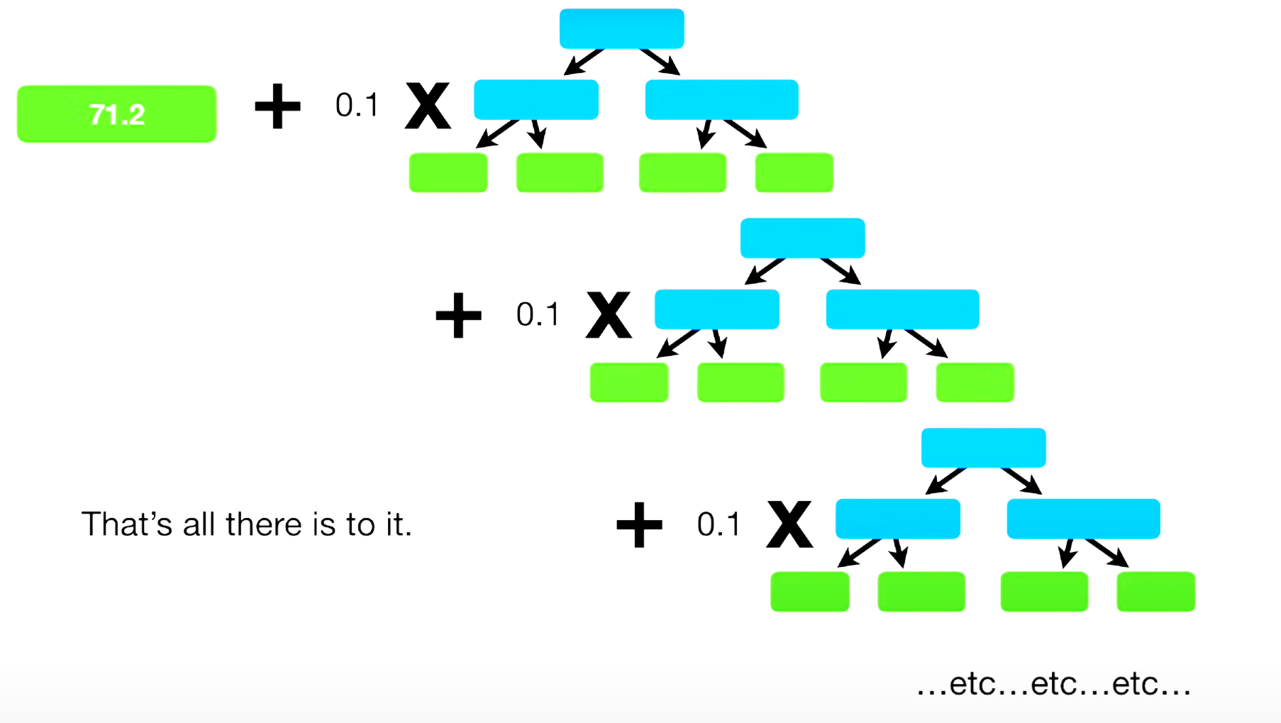
Gradient Boost
Similar to Adaboost
This method tries to fit the new predictor the residual errors made by the previous predictor

Slide 37
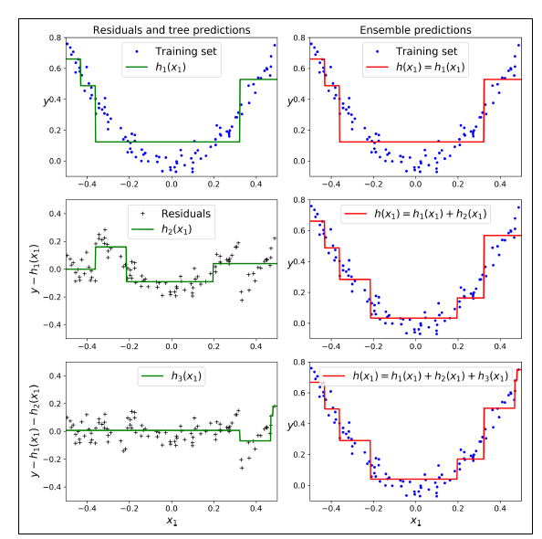
Gradient Boost
Fitting a Curve , based on iterative errors made in earlier predictor

Slide 38
Ensemble Models & Methods
Theory
Txt

Slide 39
Clustering
Coding

Slide 40
Clustering
Math’s

Slide 41


Slide 42
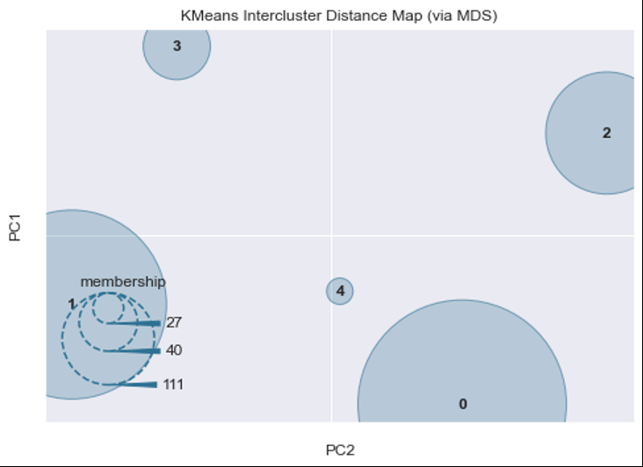
USE CASE 1 : ECH DTC - Connection to EVSE Lost Due to External Failure
Signals Identification:
1. Vehicle Charge Coupler Detector Signals
2. SOC Status
3. Hardware Control Signals
4. Communication Signals
5. IEC 61851 , 15118 compliant charging relevant signals
Identification:
1. Take a reference file
2. Detection of evolution pattern using DTW
3. Differentiation of pattern based on the distance metric
Result: Five patterns have been identified for this error of which three are most significant.
Signal Preparation:
Take the relevant trace files
Clip them from the point where the DTC occurred to 120 seconds prior to that
Remove SNAs

Slide 43
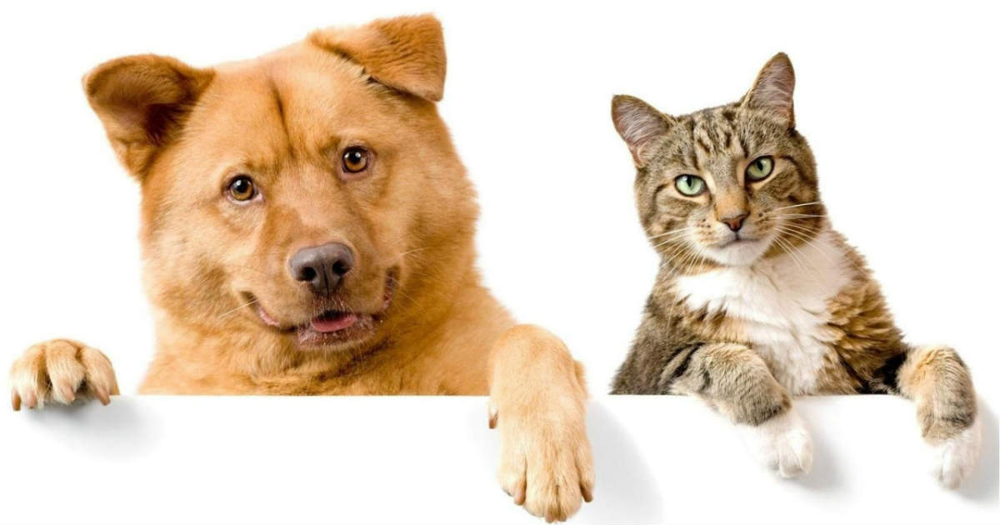
Dog Vs Cat Classification

Slide 44
@indhra
Data Scientist - Fleet Monitoring
M.Tech - Controls & Automation (Machine Learning)
Microsoft Certified Azure Data Scientist Associate
Kaggle Competition Winner
Open-Source Contributor

